Slide 1
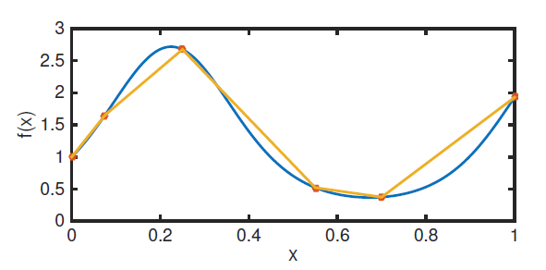
Chapter 5 Interpolation and Calculus

Slide 2
Interpolation
We are interested in this on several levels.
We can:
Approximate data if we have just the right amount of data for the functions we want to use
Approximate functions
Develop error formulae for the difference between the interpolant and a given function
Develop methods for approximating derivatives and integrals (calculus)
We will mostly focus on the last three

Slide 3
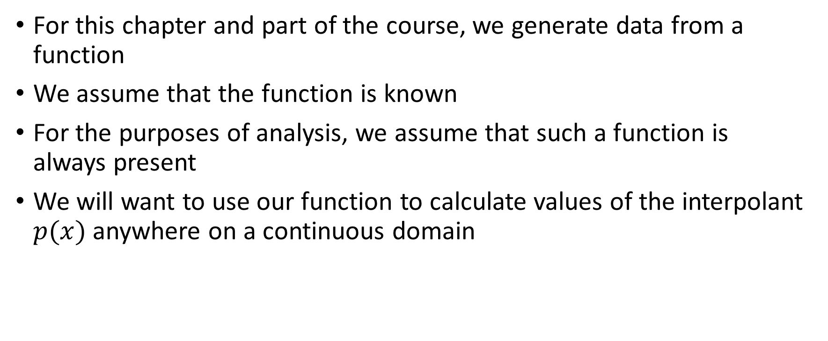
Interpolation
For this chapter and part of the course, we generate data from a function
We assume that the function is known
For the purposes of analysis, we assume that such a function is always present
We will want to use our function to calculate values of the interpolant $p(x)$ anywhere on a continuous domain

Slide 4
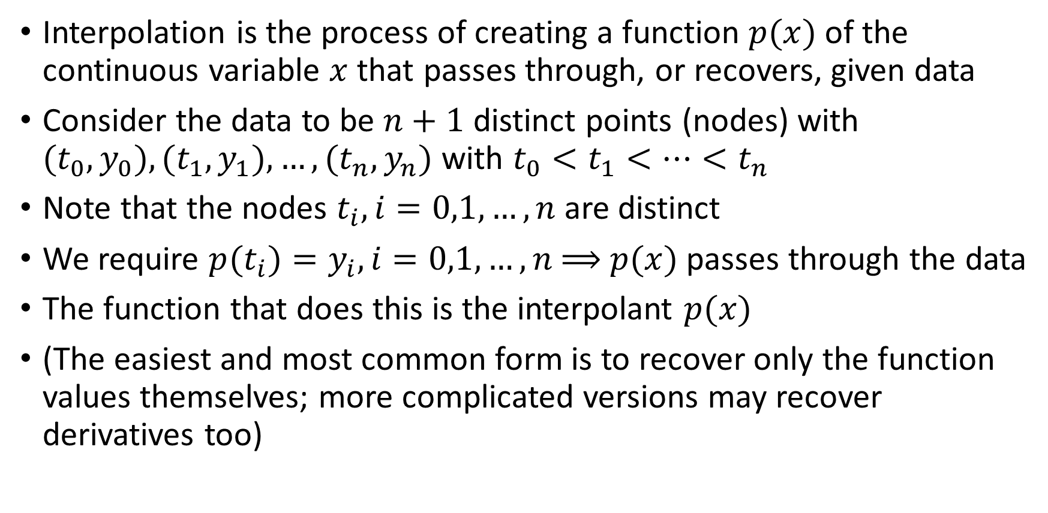
Interpolation
Interpolation is the process of creating a function $p(x)$ of the continuous variable $x$ that passes through, or recovers, given data
Consider the data to be $n+1$ distinct points (nodes) with $(t_{0},y_{0}), (t_{1},y_{1}),…,(t_{n},y_{n})$ with $t_{0}<t_{1}<…<t_{n}$
Note that the nodes $t_{i}, i=0,1,…,n$are distinct
We require $p(t_{i})=y_{i}, i=0,1,…,n$⟹ $p(x)$ passes through the data
The function that does this is the interpolant $p(x)$
(The easiest and most common form is to recover only the function values themselves; more complicated versions may recover derivatives too)

Slide 5
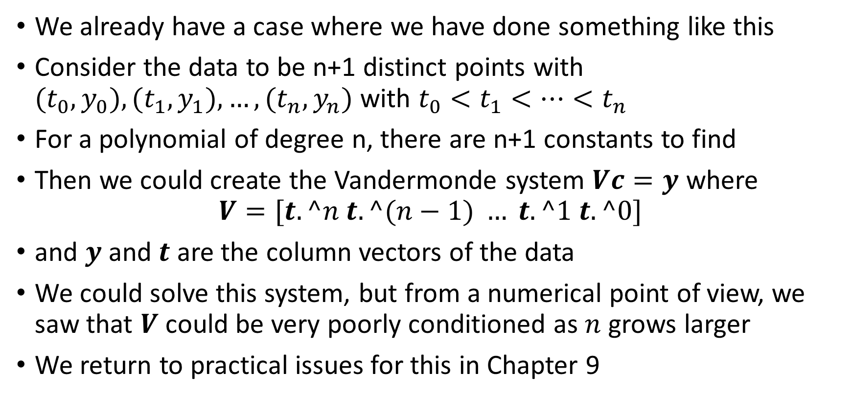
Interpolation
We already have a case where we have done something like this
Consider the data to be n+1 distinct points with $(t_{0},y_{0}), (t_{1},y_{1}),…,(t_{n},y_{n})$ with $t_{0}<t_{1}<…<t_{n}$
For a polynomial of degree n, there are n+1 constants to find
Then we could create the Vandermonde system $Vc=y$ where
$$V=[t.^n t.^(n−1) … t.^1 t.^0]$$
and $y$ and $t$ are the column vectors of the data
We could solve this system, but from a numerical point of view, we saw that $V$ could be very poorly conditioned as $n$ grows larger
We return to practical issues for this in Chapter 9

Slide 6
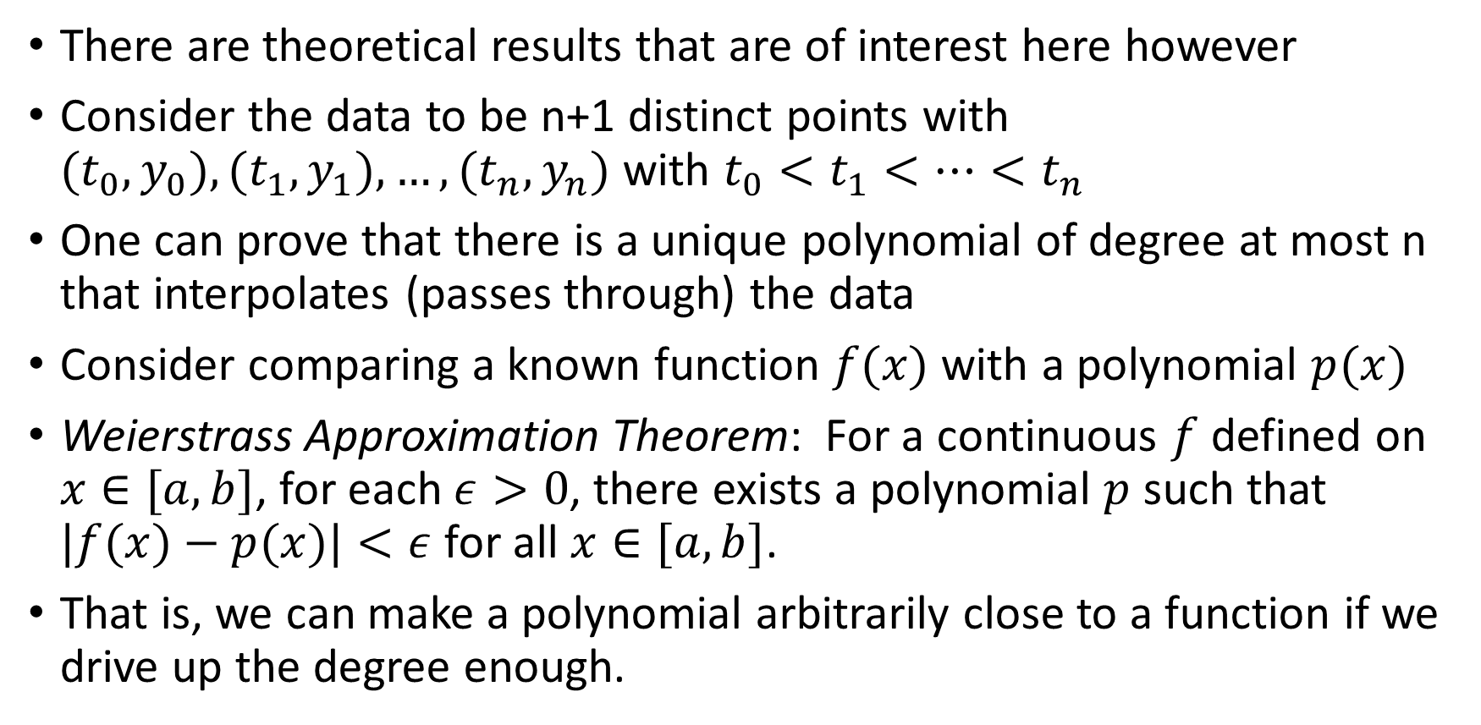
Interpolation
There are theoretical results that are of interest here however
Consider the data to be n+1 distinct points with $(t_{0},y_{0}), (t_{1},y_{1}),…,(t_{n},y_{n})$ with $t_{0}<t_{1}<…<t_{n}$
One can prove that there is a unique polynomial of degree at most n that interpolates (passes through) the data
Consider comparing a known function $f(x)$ with a polynomial $p(x)$
Weierstrass Approximation Theorem: For a continuous $f$defined on $x∈[a,b]$, for each $ε>0$, there exists a polynomial $p$ such that $|f(x)−p(x)|<ε$for all $x∈[a,b]$.
That is, we can make a polynomial arbitrarily close to a function if we drive up the degree enough.

Slide 7
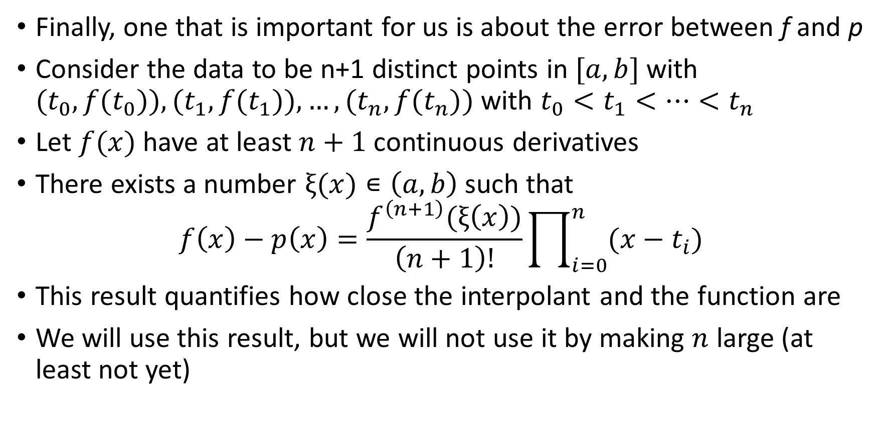
Interpolation
Finally, one that is important for us is about the error between f and p
Consider the data to be n+1 distinct points in $[a,b]$with $(t_{0},{f(t}_{0})), (t_{1},{f(t}_{1})),…,(t_{n},{f(t}_{n}))$ with $t_{0}<t_{1}<…<t_{n}$
Let $f(x)$ have at least $n+1$ continuous derivatives
There exists a number $ξ(x)∊\left(a,b\right)$ such that
$$f\left(x\right)−p\left(x\right)=\frac{f^{\left(n+1\right)}(ξ\left(x\right))}{\left(n+1\right)!}\prod_{i=0}^{n}{(x−t_{i})}$$
This result quantifies how close the interpolant and the function are
We will use this result, but we will not use it by making $n$ large (at least not yet)

Slide 8
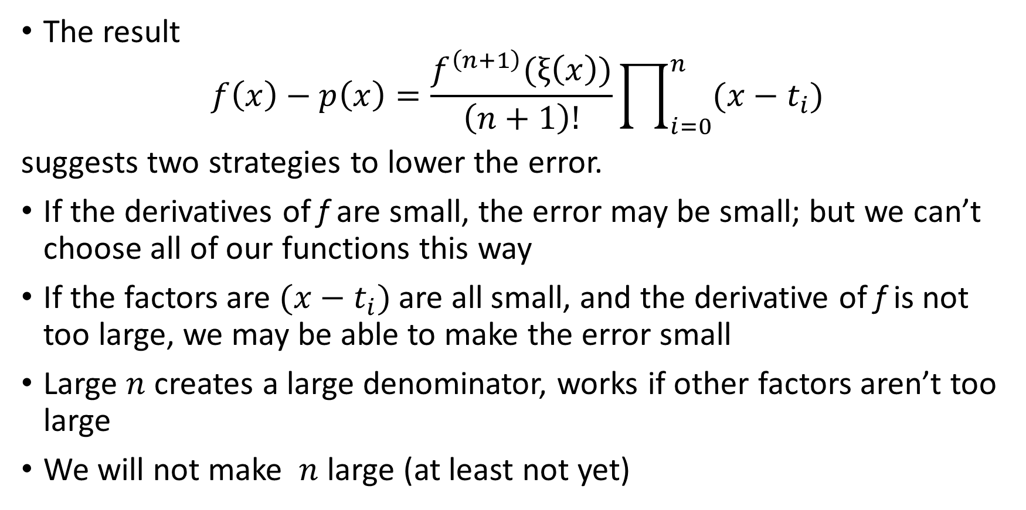
Interpolation
The result
$$f\left(x\right)−p\left(x\right)=\frac{f^{\left(n+1\right)}(ξ\left(x\right))}{\left(n+1\right)!}\prod_{i=0}^{n}{(x−t_{i})}$$
suggests two strategies to lower the error.
If the derivatives of f are small, the error may be small; but we can’t choose all of our functions this way
If the factors are $(x−t_{i})$are all small, and the derivative of f is not too large, we may be able to make the error small
Large $n$ creates a large denominator, works if other factors aren’t too large
We will not make $n$ large (at least not yet)

Slide 9

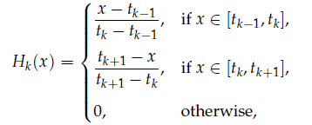
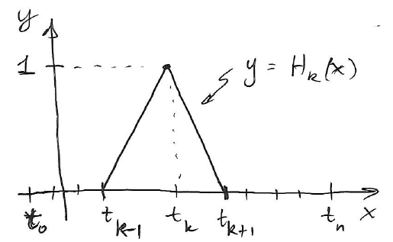
Piecewise linear interpolation
This is great for one interval, but is not so easy to generalize for all subintervals
Let’s rewrite how we do the pcwise linear interpolant
First, let’s create a simple “cardinal function” which returns 1 at a node of interest, and 0 at every other node:

Slide 10
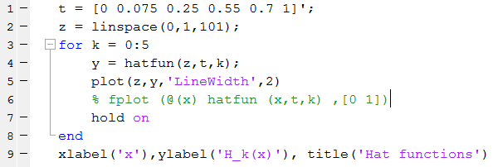
Piecewise linear interpolation
This will allow us to draw hats or tents with a 1 at each node
Here’s a way to do it in Matlab:
Uses textbook hat function

Slide 11
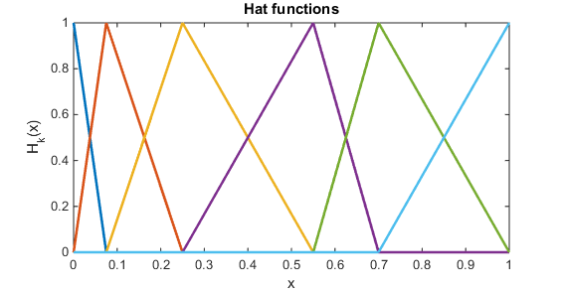
Piecewise linear interpolation
The nodes are the six given t values.
Each color is one hat function
Ends have half of one
Let’s look at details

Slide 12
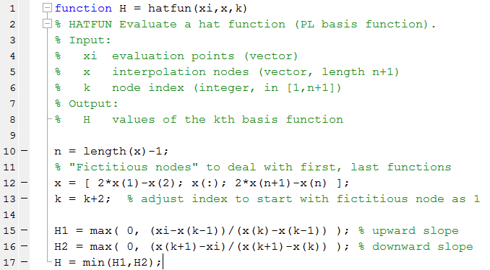
Piecewise linear interpolation
Text Matlab function:

Slide 13
Piecewise linear interpolation
Text Matlab function:
Sets max value starting from 0 index

Slide 14
Piecewise linear interpolation
Text Matlab function:
Add extra points with same spacing as ends in given data

Slide 15
Piecewise linear interpolation
Text Matlab function:
Shift index to start at 1

Slide 16
Piecewise linear interpolation
Text Matlab function:
Choose correct part of hat function from 4 possibilities

Slide 17
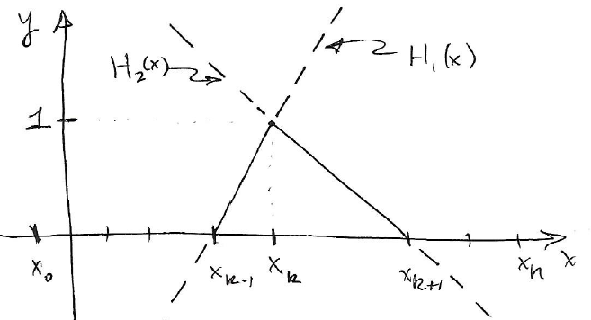

Piecewise linear interpolation
Here’s a sketch of parts of the hat function
For node $k$, $H_{1}(x)$ and $H_{2}(x)$ are sketched
We want the solid parts

Slide 18
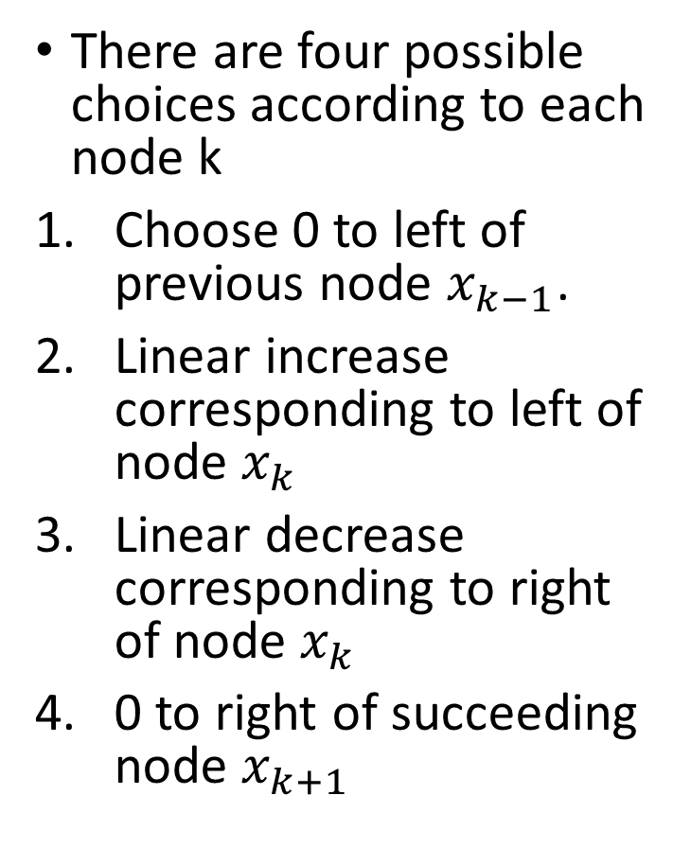
Piecewise linear interpolation
There are four possible choices according to each node k
Choose 0 to left of previous node $x_{k−1}$.
Linear increase corresponding to left of node $x_{k}$
Linear decrease corresponding to right of node $x_{k}$
0 to right of succeeding node $x_{k+1}$

Slide 19
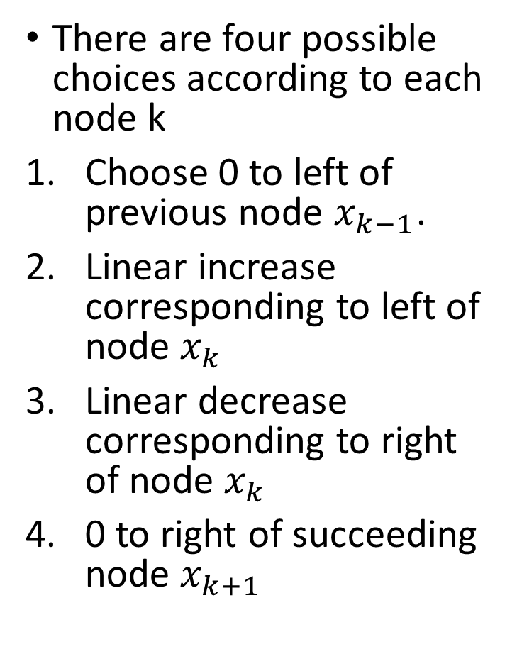
Piecewise linear interpolation
There are four possible choices according to each node k
Choose 0 to left of previous node $x_{k−1}$.
Linear increase corresponding to left of node $x_{k}$
Linear decrease corresponding to right of node $x_{k}$
0 to right of succeeding node $x_{k+1}$

Slide 20
Piecewise linear interpolation
There are four possible choices according to each node k
Choose 0 to left of previous node $x_{k−1}$.
Linear increase corresponding to left of node $x_{k}$
Linear decrease corresponding to right of node $x_{k}$
0 to right of succeeding node $x_{k+1}$

Slide 21
Piecewise linear interpolation
There are four possible choices according to each node k
Choose 0 to left of previous node $x_{k−1}$.
Linear increase corresponding to left of node $x_{k}$
Linear decrease corresponding to right of node $x_{k}$
0 to right of succeeding node $x_{k+1}$

Slide 22


Piecewise linear interpolation
We want to build the PL interpolant from
But, the hat functions satisy the “cardinal conditions” which returns 1 at a node of interest, and 0 at every other node:
This makes the algebra trivial…

Slide 23

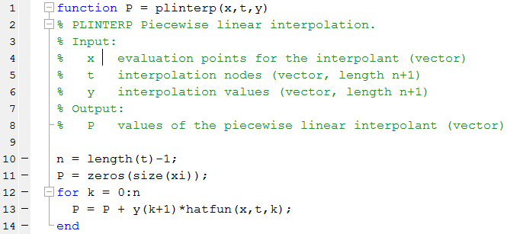
Piecewise linear interpolation
We can easily recover the data by requiring
This makes it easy to do this kind of interpolation once you can make the hat functions

Slide 24
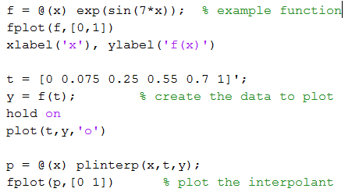
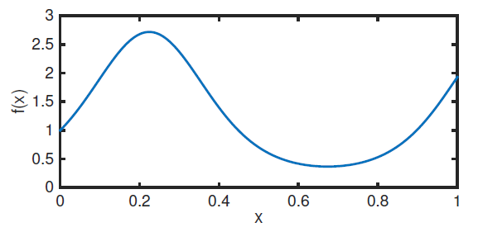
PL interpolation example

Slide 25
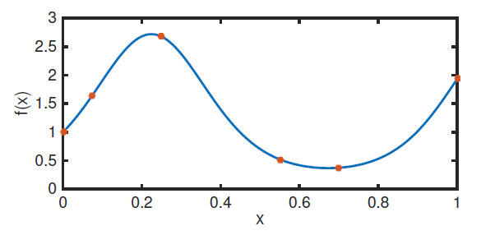
PL interpolation example

Slide 26
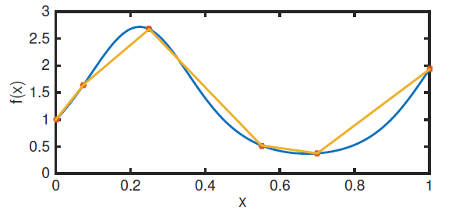
PL interpolation example

Slide 27

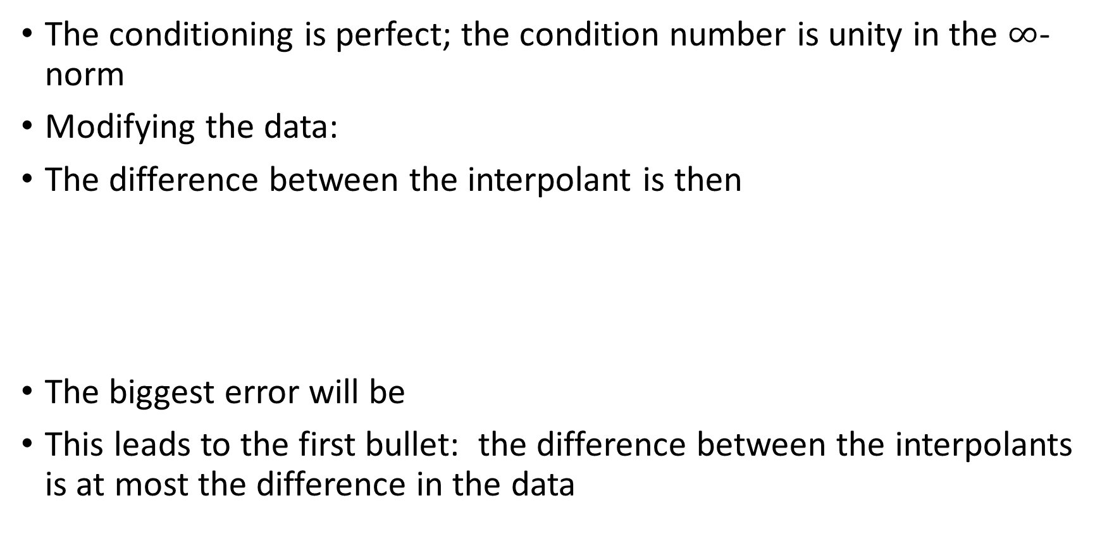
PL Interpolation
The conditioning is perfect; the condition number is unity in the $∞$-norm
Modifying the data:
The difference between the interpolant is then
The biggest error will be
This leads to the first bullet: the difference between the interpolants is at most the difference in the data

Slide 28


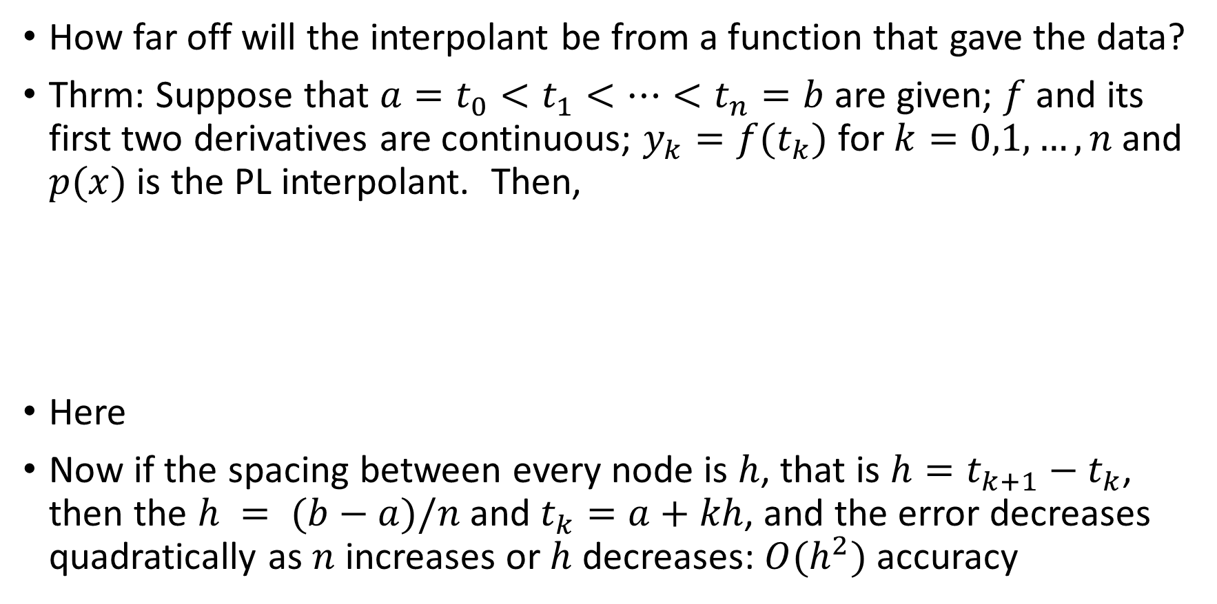
PL Interpolation
How far off will the interpolant be from a function that gave the data?
Thrm: Suppose that $a=t_{0}<t_{1}<…<t_{n}=b$are given; $f$ and its first two derivatives are continuous; $y_{k}=f(t_{k})$ for $k=0,1,…,n$ and $p(x)$ is the PL interpolant. Then,
Here
Now if the spacing between every node is $h$, that is $h=t_{k+1}−t_{k}$, then the $h = (b−a)/n$and $t_{k}=a+kh$, and the error decreases quadratically as $n$ increases or $h$ decreases: $O(h^{2})$ accuracy

Slide 29
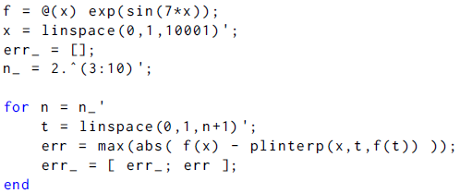
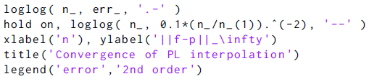
PL interpolation convergence
Example function
Comparison sequence
Compute error in lots of
node sets
Plot error and
comparison sequence

Slide 30
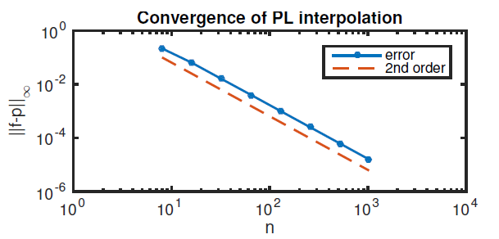
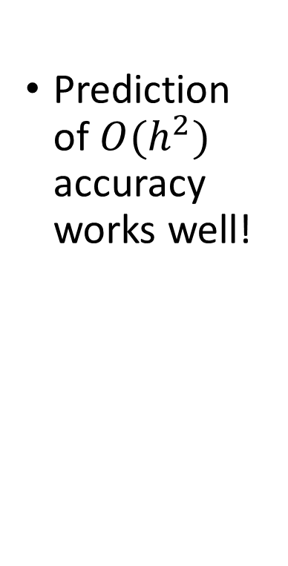
PL interpolation convergence
Prediction of $O(h^{2})$ accuracy works well!

Slide 31
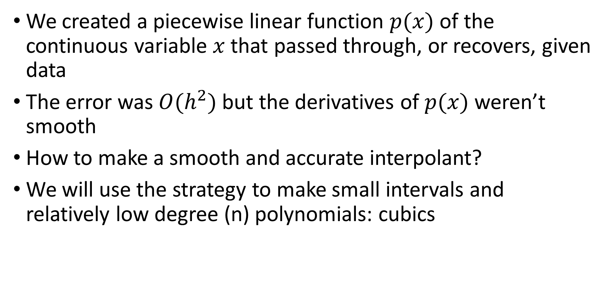
Interpolation – cubic splines
We created a piecewise linear function $p(x)$ of the continuous variable $x$ that passed through, or recovers, given data
The error was $O(h^{2})$ but the derivatives of $p(x)$ weren’t smooth
How to make a smooth and accurate interpolant?
We will use the strategy to make small intervals and relatively low degree (n) polynomials: cubics

Slide 32
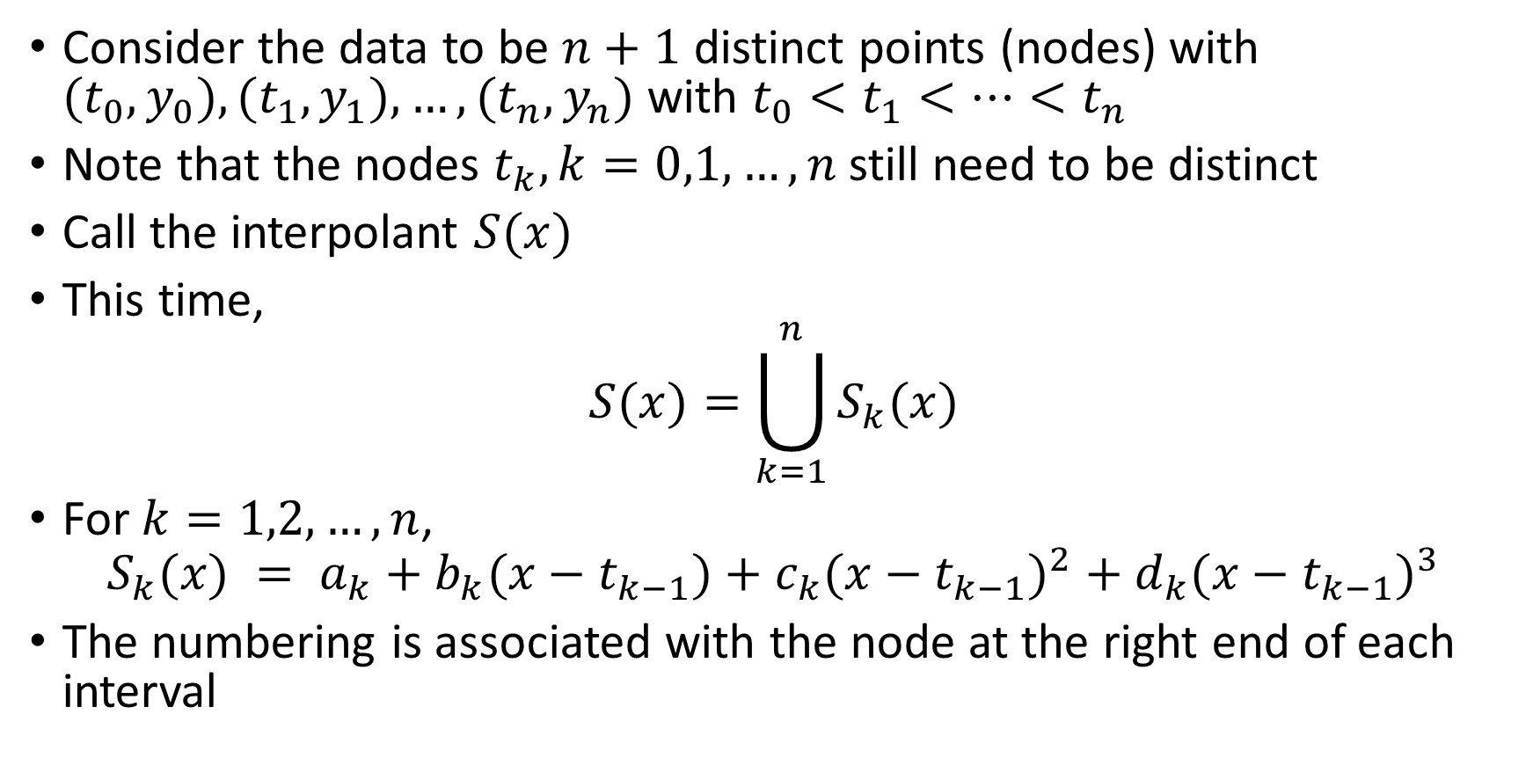
Interpolation – cubic splines
Consider the data to be $n+1$ distinct points (nodes) with $(t_{0},y_{0}), (t_{1},y_{1}),…,(t_{n},y_{n})$ with $t_{0}<t_{1}<…<t_{n}$
Note that the nodes $t_{k}, k=0,1,…,n$still need to be distinct
Call the interpolant $S(x)$
This time,
$$S(x)=\bigcup_{k=1}^{n}{S_{k}(x)}$$
For $k=1,2,…,n$,
$$S_{k}(x) = a_{k}+b_{k}(x−t_{k−1})+c_{k}({x−t_{k−1})}^{2}+d_{k}({x−t_{k−1})}^{3}$$
The numbering is associated with the node at the right end of each interval

Slide 33
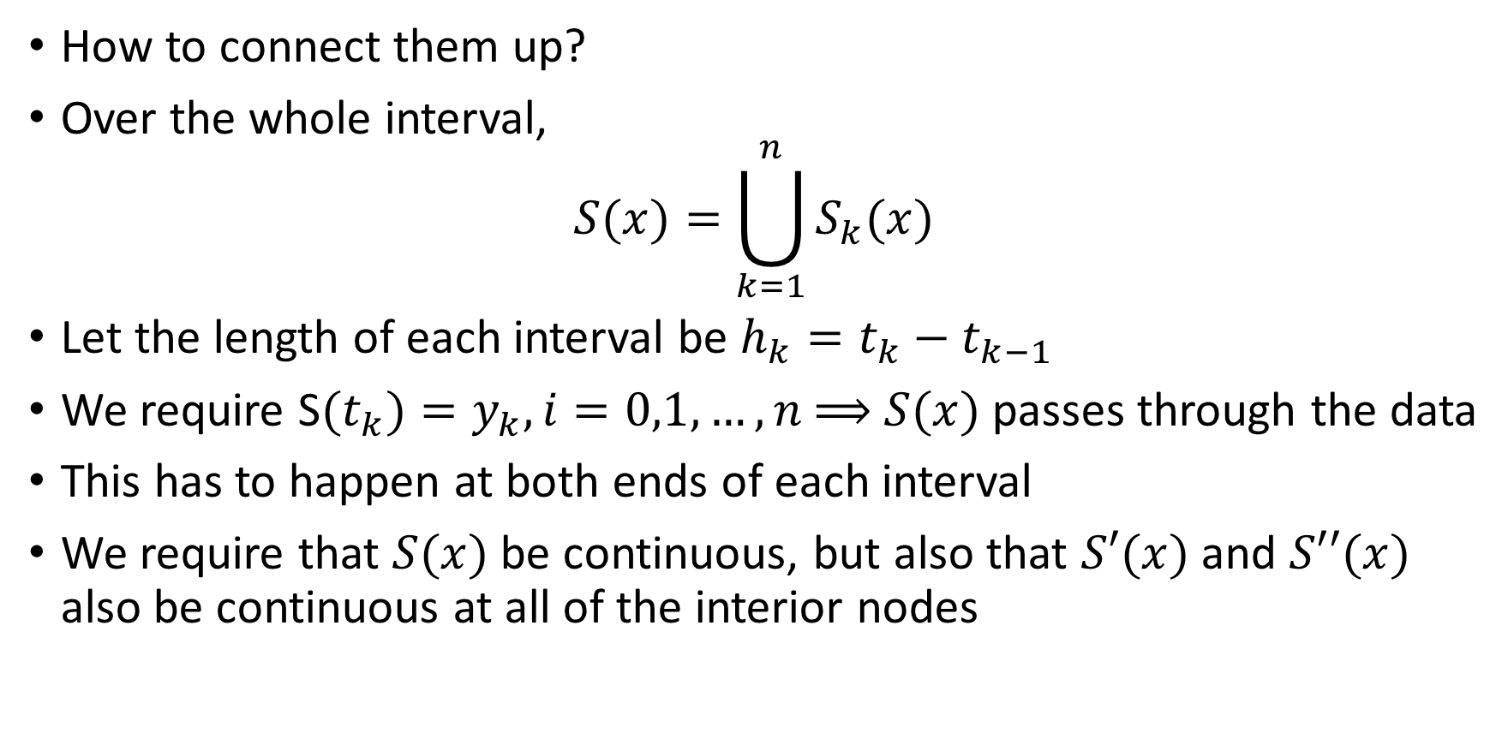
Interpolation – cubic splines
How to connect them up?
Over the whole interval,
$$S(x)=\bigcup_{k=1}^{n}{S_{k}(x)}$$
Let the length of each interval be $h_{k}=t_{k}−t_{k−1}$
We require S$(t_{k})=y_{k}, i=0,1,…,n$⟹ $S(x)$ passes through the data
This has to happen at both ends of each interval
We require that $S(x)$ be continuous, but also that $S′(x)$ and $S′′(x)$ also be continuous at all of the interior nodes

Slide 34
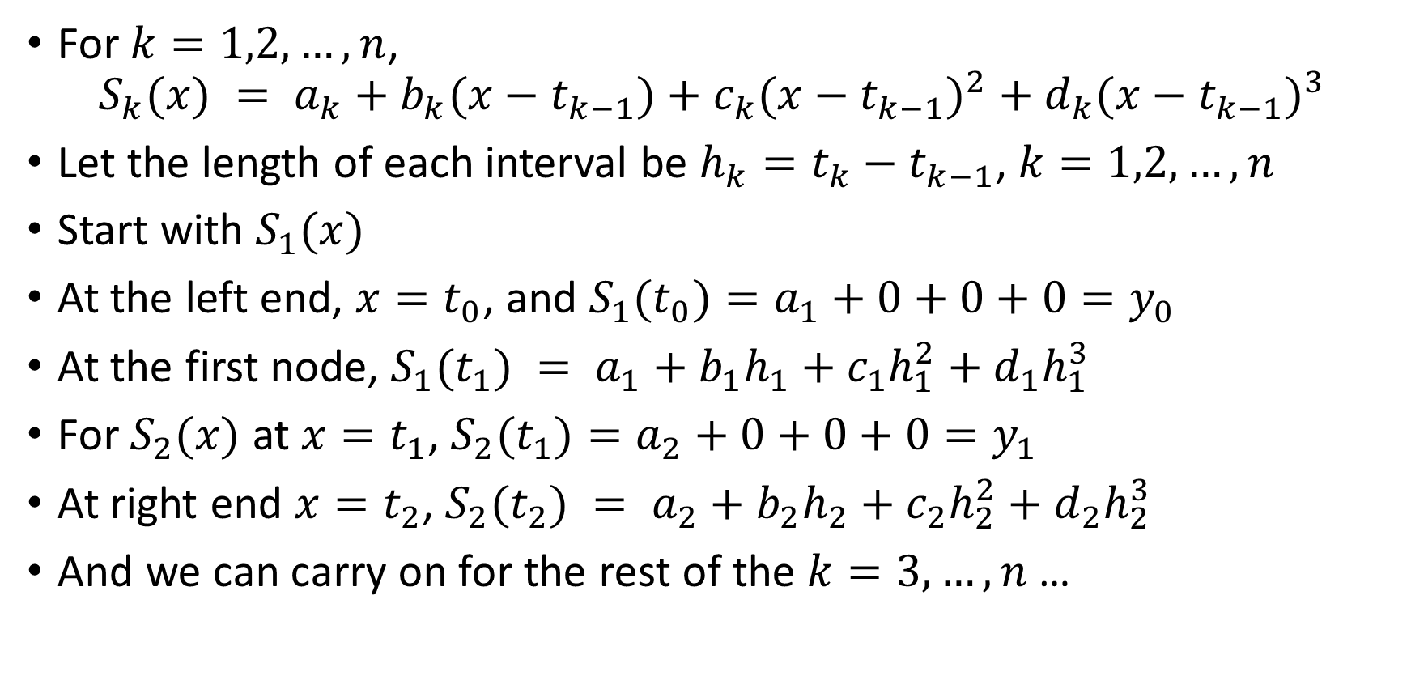
Interpolation – cubic splines
For $k=1,2,…,n$,
$$S_{k}(x) = a_{k}+b_{k}(x−t_{k−1})+c_{k}({x−t_{k−1})}^{2}+d_{k}({x−t_{k−1})}^{3}$$
Let the length of each interval be $h_{k}=t_{k}−t_{k−1}$, $k=1,2,…,n$
Start with $S_{1}(x)$
At the left end, $x=t_{0}$, and $S_{1}(t_{0})=a_{1}+0+0+0=y_{0}$
At the first node, $S_{1}(t_{1}) = a_{1}+b_{1}h_{1}+c_{1}h_{1}^{2}+d_{1}h_{1}^{3}$
For $S_{2}(x)$ at $x=t_{1}$, $S_{2}(t_{1})=a_{2}+0+0+0=y_{1}$
At right end $x=t_{2}$, $S_{2}(t_{2}) = a_{2}+b_{2}h_{2}+c_{2}h_{2}^{2}+d_{2}h_{2}^{3}$
And we can carry on for the rest of the $k=3,…,n$…

Slide 35
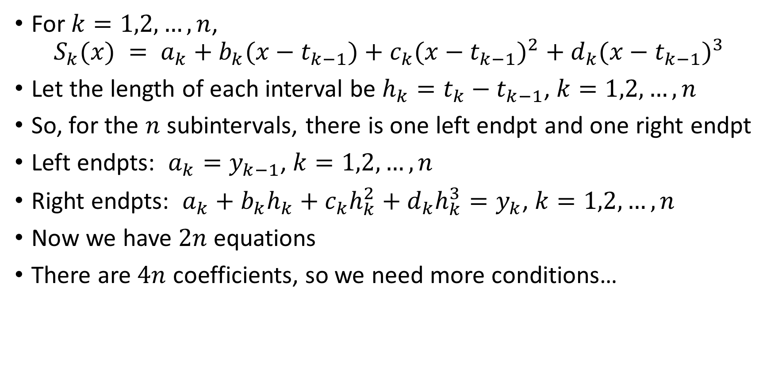
Interpolation – cubic splines
For $k=1,2,…,n$,
$$S_{k}(x) = a_{k}+b_{k}(x−t_{k−1})+c_{k}({x−t_{k−1})}^{2}+d_{k}({x−t_{k−1})}^{3}$$
Let the length of each interval be $h_{k}=t_{k}−t_{k−1}$, $k=1,2,…,n$
So, for the $n$ subintervals, there is one left endpt and one right endpt
Left endpts: $a_{k}=y_{k−1}$, $k=1,2,…,n$
Right endpts: $a_{k}+b_{k}h_{k}+c_{k}h_{k}^{2}+d_{k}h_{k}^{3}=y_{k}$, $k=1,2,…,n$
Now we have $2n$ equations
There are $4n$ coefficients, so we need more conditions…

Slide 36
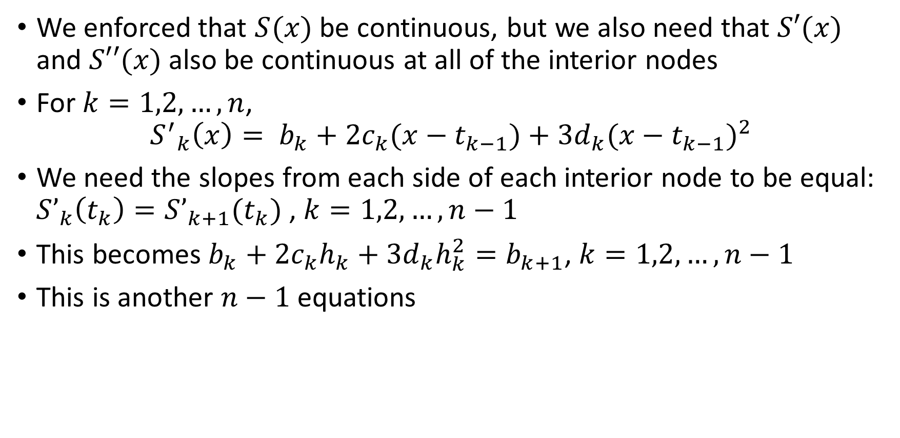
Interpolation – cubic splines
We enforced that $S(x)$ be continuous, but we also need that $S′(x)$ and $S′′(x)$ also be continuous at all of the interior nodes
For $k=1,2,…,n$,
$${S^{′}}_{k}\left(x\right)= b_{k}+{2c}_{k}(x−t_{k−1})+{3d}_{k}({x−t_{k−1})}^{2}$$
We need the slopes from each side of each interior node to be equal: $S’_{k}\left(t_{k}\right)=S’_{k+1}(t_{k})$, $k=1,2,…,n−1$
This becomes $b_{k}+{2c}_{k}h_{k}+{3d}_{k}h_{k}^{2}=b_{k+1}$, $k=1,2,…,n−1$
This is another $n−1$ equations

Slide 37
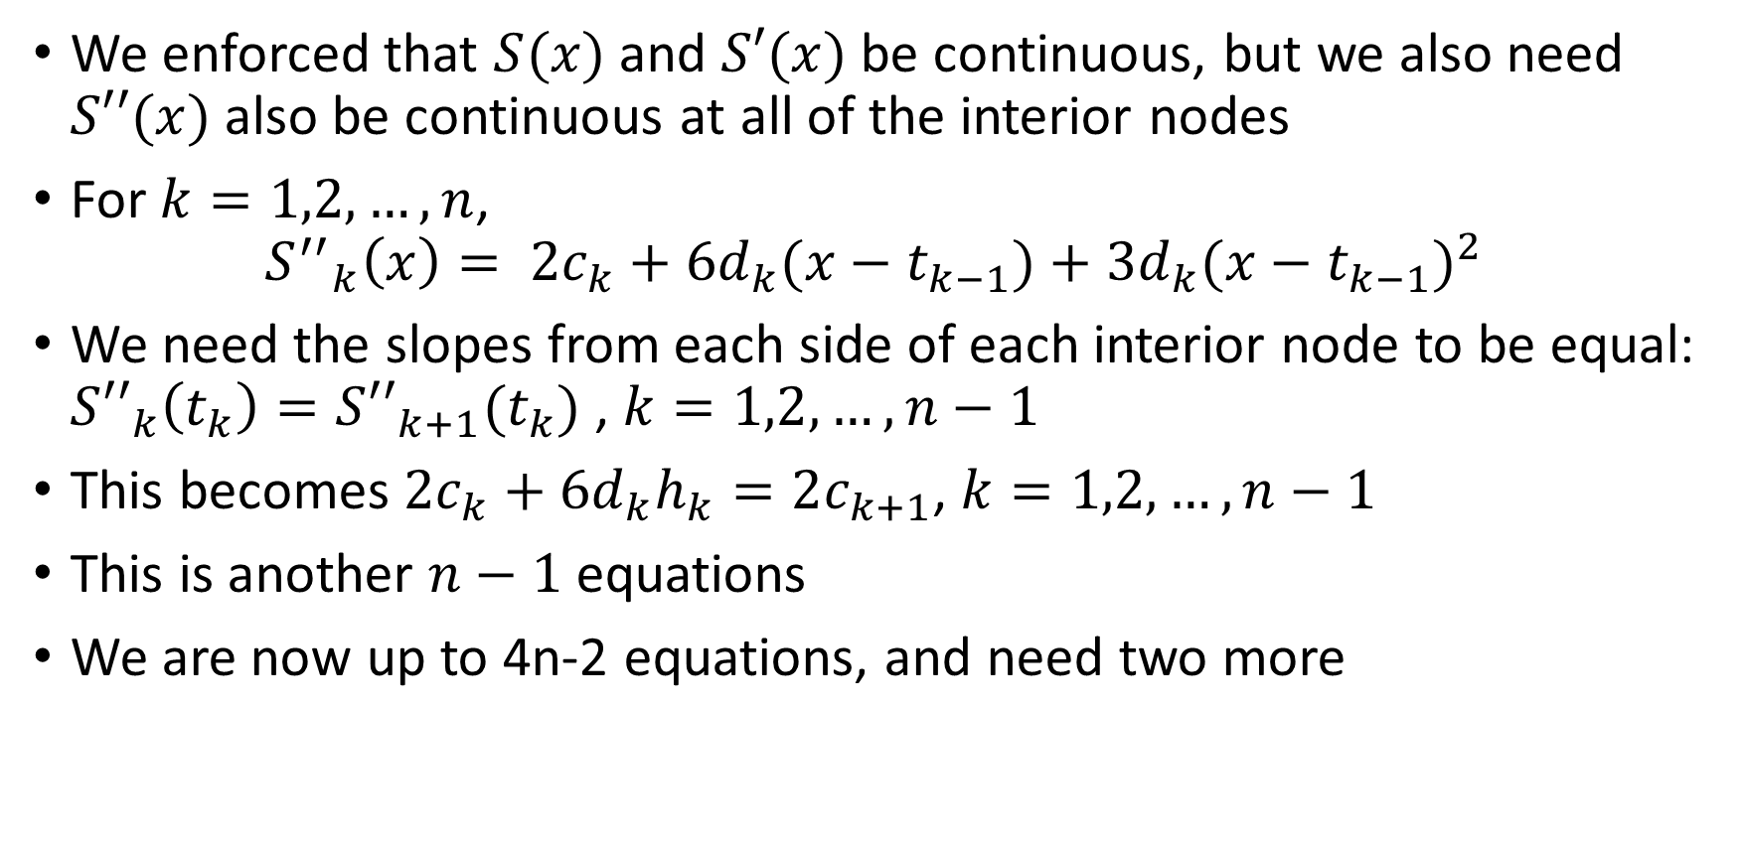
Interpolation – cubic splines
We enforced that $S(x)$ and $S′(x)$ be continuous, but we also need $S′′(x)$ also be continuous at all of the interior nodes
For $k=1,2,…,n$,
$${S^{′′}}_{k}\left(x\right)= {2c}_{k}+{6d}_{k}(x−t_{k−1})+{3d}_{k}({x−t_{k−1})}^{2}$$
We need the slopes from each side of each interior node to be equal: $S{′′}_{k}\left(t_{k}\right)=S{′′}_{k+1}(t_{k})$, $k=1,2,…,n−1$
This becomes ${2c}_{k}+{6d}_{k}h_{k}=2c_{k+1}$, $k=1,2,…,n−1$
This is another $n−1$ equations
We are now up to 4n-2 equations, and need two more

Slide 38
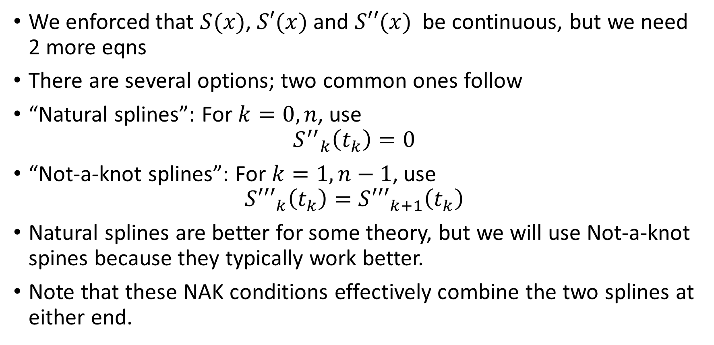
Interpolation – cubic splines
We enforced that $S(x)$, $S′(x)$ and $S′′(x)$ be continuous, but we need 2 more eqns
There are several options; two common ones follow
“Natural splines”: For $k=0,n$, use
$${S^{′′}}_{k}\left(t_{k}\right)=0$$
“Not-a-knot splines”: For $k=1,n−1$, use
$$S{′′′}_{k}\left(t_{k}\right)=S{′′′}_{k+1}\left(t_{k}\right)$$
Natural splines are better for some theory, but we will use Not-a-knot spines because they typically work better.
Note that these NAK conditions effectively combine the two splines at either end.

Slide 39
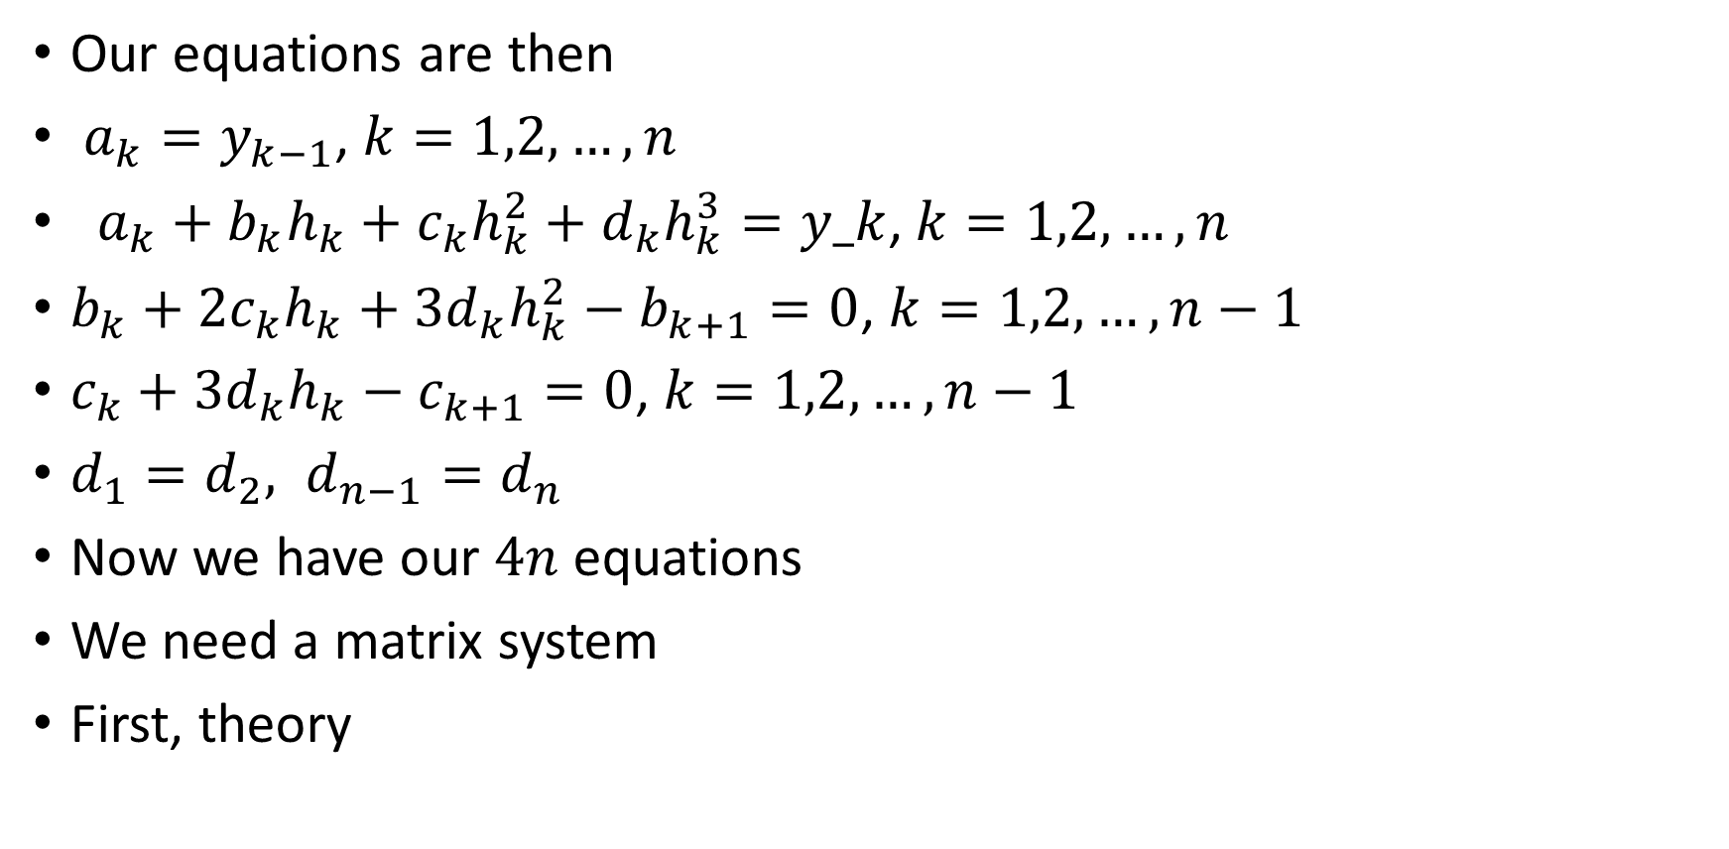
Interpolation – cubic splines
Our equations are then
$a_{k}=y_{k−1}$, $k=1,2,…,n$
$a_{k}+b_{k}h_{k}+c_{k}h_{k}^{2}+d_{k}h_{k}^{3}=y_k$, $k=1,2,…,n$
$b_{k}+{2c}_{k}h_{k}+{3d}_{k}h_{k}^{2}−b_{k+1}=0$, $k=1,2,…,n−1$
$c_{k}+{3d}_{k}h_{k}−c_{k+1}=0$, $k=1,2,…,n−1$
$d_{1}=d_{2}, d_{n−1}=d_{n}$
Now we have our $4n$ equations
We need a matrix system
First, theory

Slide 40
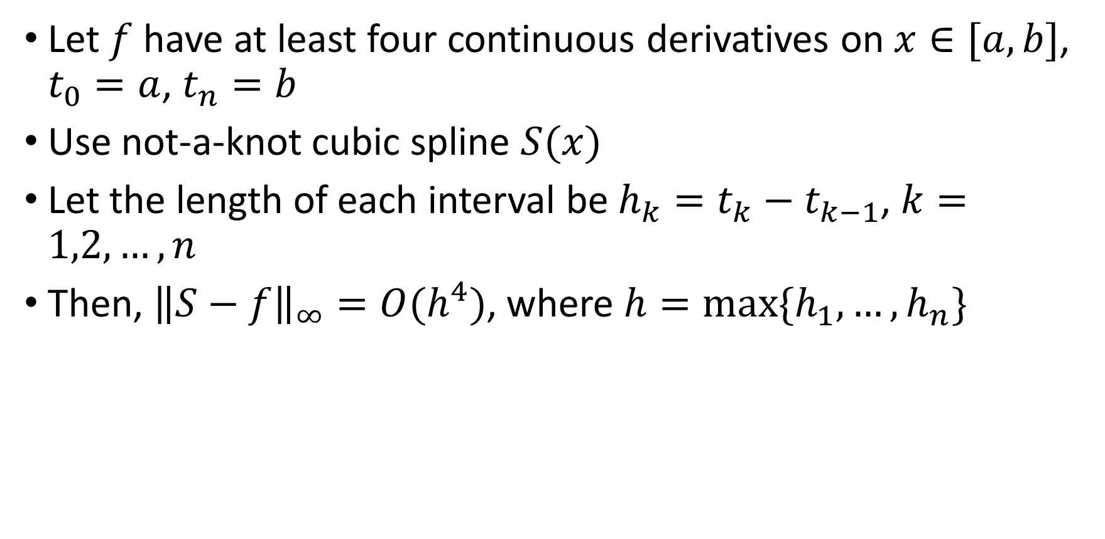
Interpolation – cubic splines
Let $f$ have at least four continuous derivatives on $x∈[a,b]$, $t_{0}=a$, $t_{n}=b$
Use not-a-knot cubic spline $S(x)$
Let the length of each interval be $h_{k}=t_{k}−t_{k−1}$, $k=1,2,…,n$
Then, ${\left\|S−f\right\|}_{∞}=O(h^{4})$, where $h=max⁡\{h_{1},…,h_{n}\}$

Slide 41
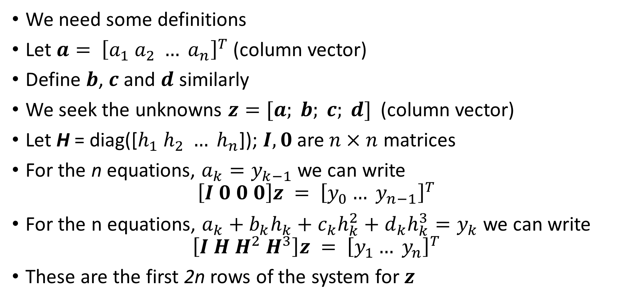
Interpolation – cubic splines
We need some definitions
Let $a= {\left[a_{1} a_{2} … a_{n}\right]}^{T}$ (column vector)
Define $b$, $c$ and $d$ similarly
We seek the unknowns $z=[a; b; c; d]$(column vector)
Let H = diag([$h_{1} h_{2} … h_{n}$]); $I, 0$are $n×n$ matrices
For the n equations, $a_{k}=y_{k−1}$ we can write
$$\left[I 0 0 0\right]z = {\left[y_{0}… y_{n−1}\right]}^{T}$$
For the n equations, $a_{k}+b_{k}h_{k}+c_{k}h_{k}^{2}+d_{k}h_{k}^{3}=y_{k}$ we can write
$$\left[I H H^{2} H^{3}\right]z = {\left[y_{1}… y_{n}\right]}^{T}$$
These are the first 2n rows of the system for $z$

Slide 42
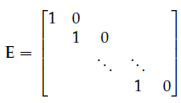
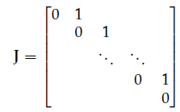

Interpolation – cubic splines
For the $n−1$ first derivative eqns $b_{k}+{2c}_{k}h_{k}+{3d}_{k}h_{k}^{2}−b_{k+1}=0$,
$$E\left[0 I−J 2H {3H}^{2}\right]z =0$$
$0$ is a $n×1$ vector here
Here
This is the next $n−1$ rows

Slide 43
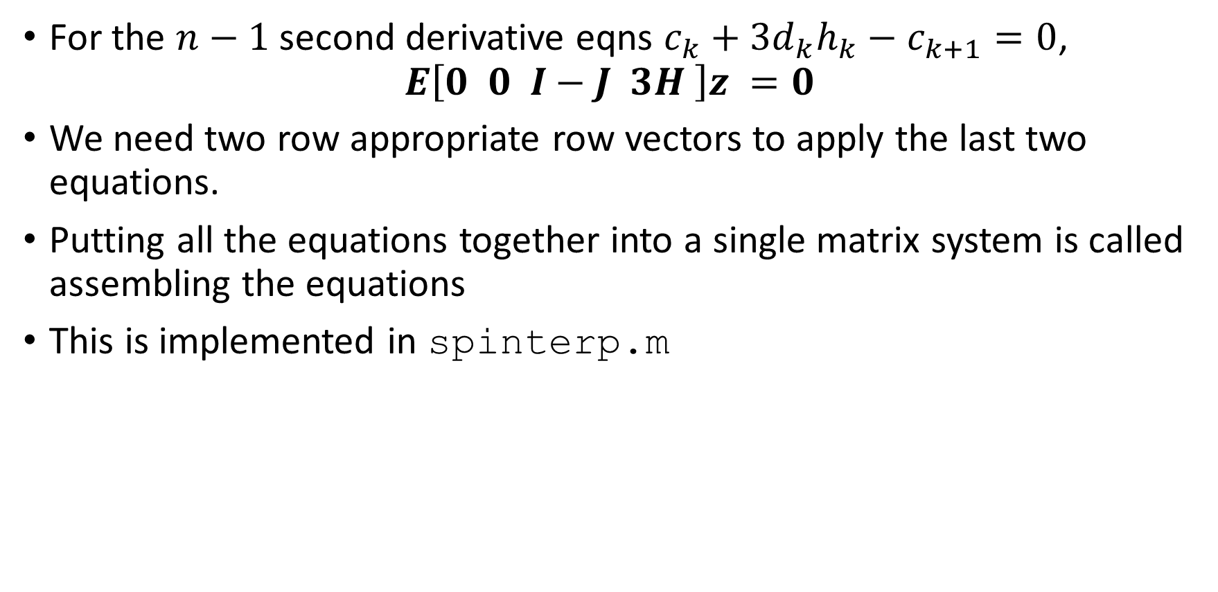
Interpolation – cubic splines
For the $n−1$ second derivative eqns $c_{k}+{3d}_{k}h_{k}−c_{k+1}=0$,
$$E\left[0 0 I−J 3H \right]z =0$$
We need two row appropriate row vectors to apply the last two equations.
Putting all the equations together into a single matrix system is called assembling the equations
This is implemented in spinterp.m

Slide 44
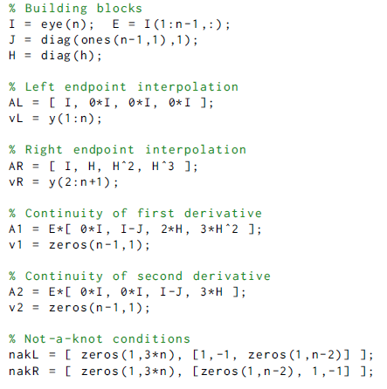
Cubic splines function
Build up parts of system for all coefficients in A’s
RHS is v’s
Last two lines are two rows for NAK conditions

Slide 45
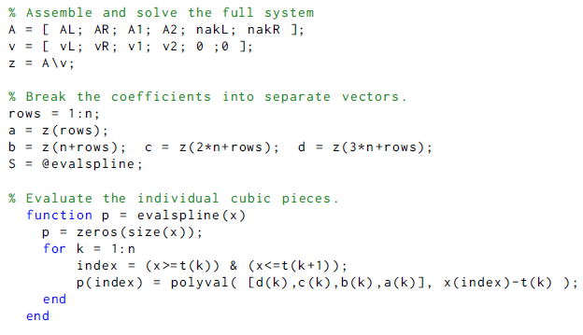
Cubic splines function
Assemble the A’s into a single matrix
Same for RHS with v’s
Solve
Break up coefficients and evaluate with polyval

Slide 46
Cubic splines -- example
Return to f(x)=exp(sin(7x))
Use 6 nodes again, t = [0, 0.075, 0.25, 0.55, 0.7, 1]
Do PL interpolation again for comparison
Then cubic spline and superimpose

Slide 47
Cubic splines example
PL first for comparison

Slide 48

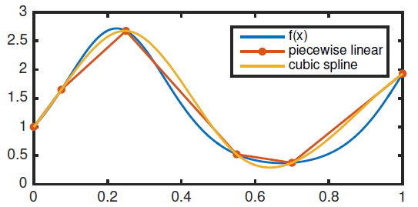
Cubic splines example
Now cubic spline
Better, but not super
Try to refine a little

Slide 49
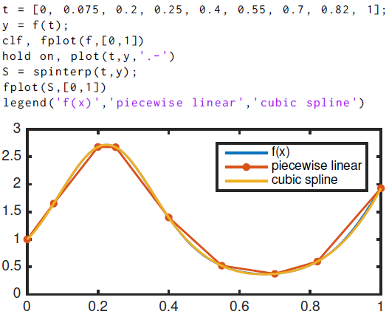
Cubic splines example
Now with more points

Slide 50
Differentiation

Slide 51

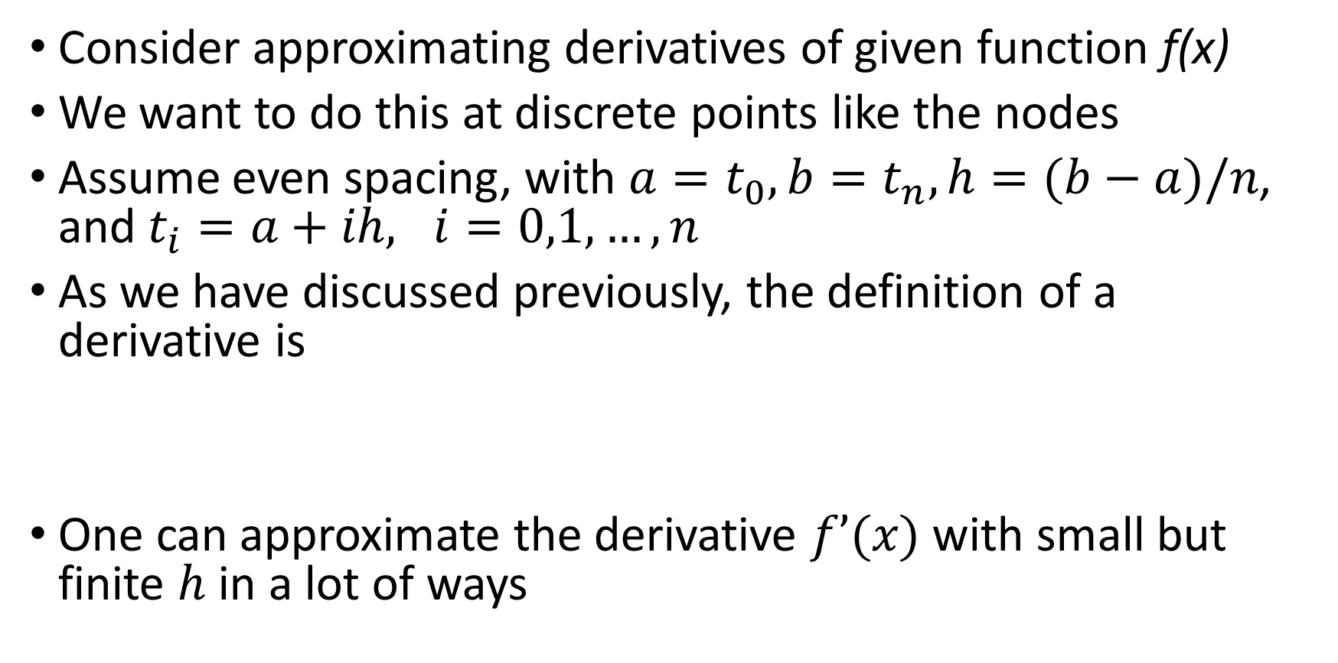
Differentiation: finite differences
Consider approximating derivatives of given function f(x)
We want to do this at discrete points like the nodes
Assume even spacing, with $a=t_{0}, b=t_{n}, h=(b−a)/n$, and $t_{i}=a+ih, i=0,1,…,n$
As we have discussed previously, the definition of a derivative is
One can approximate the derivative $f’(x)$with small but finite $h$ in a lot of ways

Slide 52

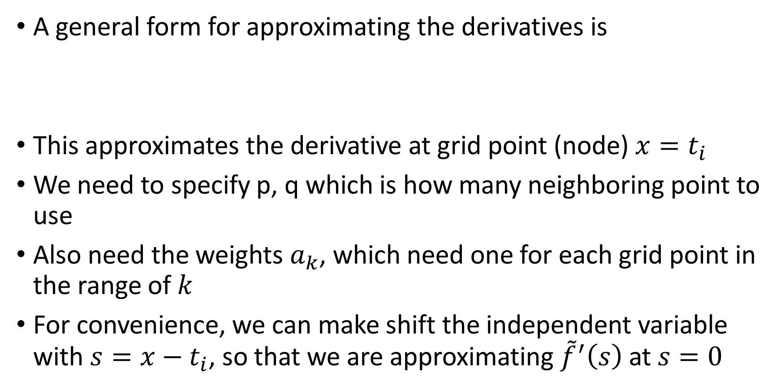
Differentiation: finite differences
A general form for approximating the derivatives is
This approximates the derivative at grid point (node) $x=t_{i}$
We need to specify p, q which is how many neighboring point to use
Also need the weights $a_{k}$, which need one for each grid point in the range of $k$
For convenience, we can make shift the independent variable with $s=x−t_{i}$, so that we are approximating ${\tilde{f}}^{′}\left(s\right)$ at $s=0$

Slide 53

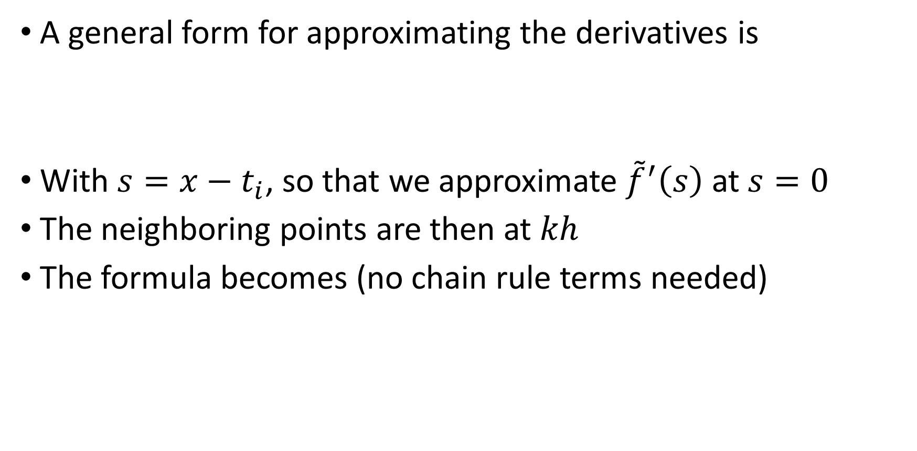
Differentiation: finite differences
A general form for approximating the derivatives is
With $s=x−t_{i}$, so that we approximate ${\tilde{f}}^{′}\left(s\right)$ at $s=0$
The neighboring points are then at $kh$
The formula becomes (no chain rule terms needed)

Slide 54


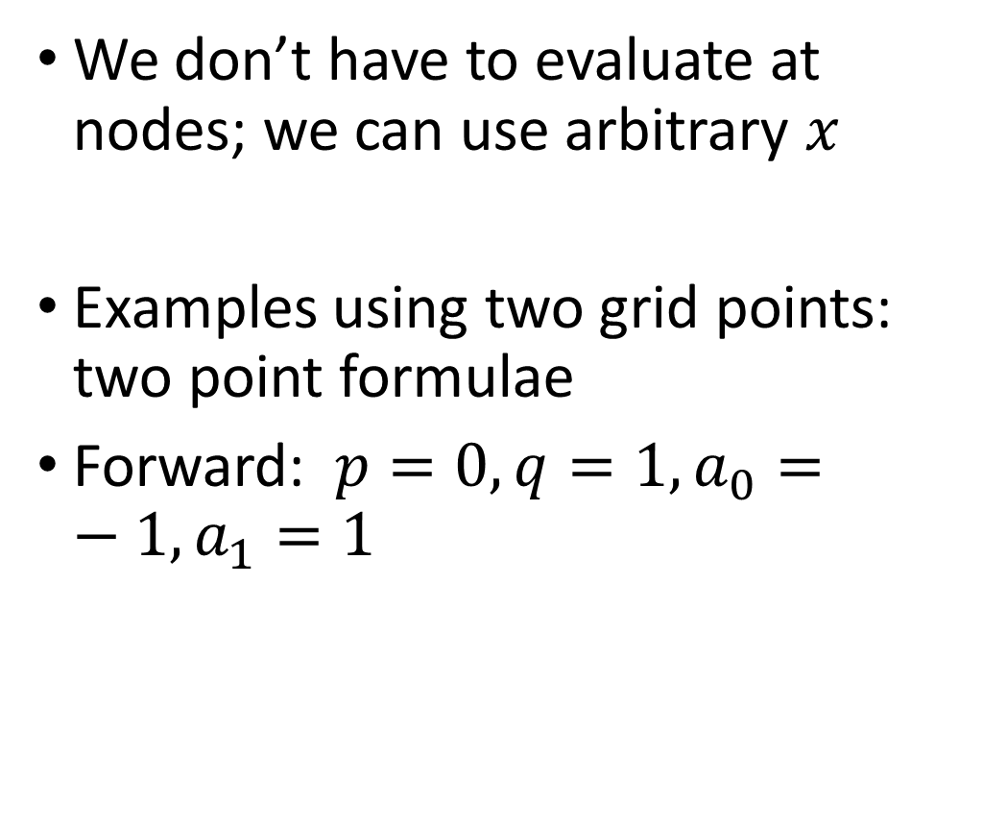
Differentiation: finite differences
We don’t have to evaluate at nodes; we can use arbitrary $x$
Examples using two grid points: two point formulae
Forward: $p=0, q=1, a_{0}=−1, a_{1}=1$

Slide 55


Differentiation: finite differences
We don’t have to evaluate at nodes; we can use arbitrary $x$
Examples using two grid points: two point formulae
Forward: $p=0, q=1, a_{0}=−1, a_{1}=1$
Backward: $p=1, q=0, a_{−1}=−1, a_{0}=1$

Slide 56


Finite differences: accuracy
How accurate are these formulas?
Define the truncation error
To evaluate what the truncation error is, Taylor expand each value of $f(kh)$ about $0$ ($k=0$)
There is cancellation of many terms, and the largest remaining term is the order of the error

Slide 57


Finite differences: accuracy
Taylor expanding about 0 and substituting gives
The biggest term in the error decreases proportional to $h$: $O(h)$ error or first order error
Can we do better?

Slide 58



Finite differences: accuracy
To get a better approximation, use more points
To do this, first use three points and interpolate them with a quadratic
Differentiating and setting x=0 gives the following:
$$f^{′}\left(0\right)≈P^{′}\left(0\right)= \frac{−1}{2h}f\left(−h\right)+0f\left(0\right)+\frac{1}{2h}f(h)$$
More neatly,

Slide 59


Finite differences: accuracy
Centered difference formula (3-pt formula)
How about the error? Taylor expand about $x=0$ again
The error is now $O(h^{2})$ (the $h^{3}$ terms don’t cancel)

Slide 60

Exploring accuracy
What difference does this make in the error?
Consider $f\left(x\right)=\sin\left(e^{x+1}\right)$
Exact derivative is $f′\left(x\right)=cos⁡(e^{x+1})$
Test them with two formulas at $x=0$
Try it in Matlab

Slide 61


Finite differences: accuracy test
Setting up the functions;
$h$ changes by factor of 2 each step
Easy to see order in that case

Slide 62

Finite differences: accuracy test
Calculate the errors

Slide 63


Finite differences: accuracy test
Calculate the errors and ratios

Slide 64


Finite differences: accuracy test
Plot the errors using loglog
Slope of $O(h)$ is 1
Slot of $O(h^{2})$ is 2
2nd order accuracy significantly better

Slide 65
Finite differences: accuracy test
For exploration: What happens for h smaller than the values used here?
Can we increase the order of accuracy further?
Use non-centered formulas?

Slide 66


Finite differences: more accuracy, one-sided
The general form:
If p=0, forward difference
If q=0, backward difference
Table at right is for finite difference formulas
A transformation of $h→−h$ will switch the forward difference to the backward difference

Slide 67


Finite differences: Higher order derivatives
We can start with quadratic polynomial
Differentiating twice results in the formula
Error is $O(h^{2})$
This is true for centered formula, but not for one-sided
Can derive using Taylor expansion or Lagrange interpolating polynomial

Slide 68


Higher order derivatives, one sided
Using a quadratic interpolating polynomial
But using a cubic interpolating polynomial gives
Better accuracy for latter but more points needed
Additional concerns can arise for differential equations, e.g.

Slide 69
General finite differences
General approach beyond this text
Function 5.3 (fdweights.m) calculates derivative approximations for the requested order of the derivative and accuracy for node locations that need not be uniformly spaced.
It uses Fornberg’s method.

Slide 70
Finite difference error
Try out script with wider range of h
That is, decrease h to very small values, even to eps
What happens as h decreases? Why?

Slide 71
Differentiation matrices

Slide 72

Derivative matrices
Say we have a list of function values:
These are located at grid or mesh points
We can calculate derivatives at each grid point in one operation if we premultiply by the correct matrix
This is a very handy operation

Slide 73




Derivative matrices
We want to compute a vector $g$ where $g_{i}≈f′(t_{i})$
Try this with the forward difference formula, with $x=t_{i}, i=0,1,…,n$
This works great for $i=0,1,…,n−1$ but we can do the same thing at $i=n$
There, just use a backward formula, which ends up just the same as for $i=n−1$

Slide 74


Finite differences: accuracy test
Putting all the rows together gives:
Then, we get a first order accurate approximation at all grid points from premultiplying by differentiation matrix $D_{x}$

Slide 75


Finite differences: accuracy test
What if we wanted $O(h^{2})$ accuracy?
This matrix gives second order accurate approximations at interior points
Ends are still only first order because we can’t apply centered formula at either end

Slide 76


Finite differences: accuracy test
What if we wanted $O(h^{2})$ accuracy at the ends too?
Use one-sided three point formulas at each end
This matrix gives second order accurate approximations at all grid points

Slide 77


2nd derivative matrix
For second derivative and $O(h^{2})$ accuracy at all points:
Use one-sided four point formulas at each end
This matrix gives second order accurate approximations at all grid points

Slide 78

Derivative matrices
In both of the cases we saw increasing the accuracy led to more nonzero diagonals
If we increase the order of accuracy more, this trend continues
Function diffmats.m from text will build the second order accurate first and second derivative matrices (most commonly used)

